Slide 1



Dissecting Microsoft OS and Office

Slide 2


Introduction
Microsoft OS: Architecture
Microsoft Office: History & Architecture
Microsoft Office & OS: Evolution
Conclusion

Slide 3
Microsoft has been a leader in the technology industry for decades.
Their operating systems and office software have become household names.

Slide 4
OS Architecture

Slide 5
Components
Kernel
User Mode
Service
Drivers
Core of the OS
Provides basic services
better support for Virtualization and Security
Responsible for running User Applications
Has several Subsystems for Network, Security and graphics
Background processes
File Management systems, Printing and Network Connection
Allow OS to communicate with the hardware
Loaded into kernel mode

Slide 6
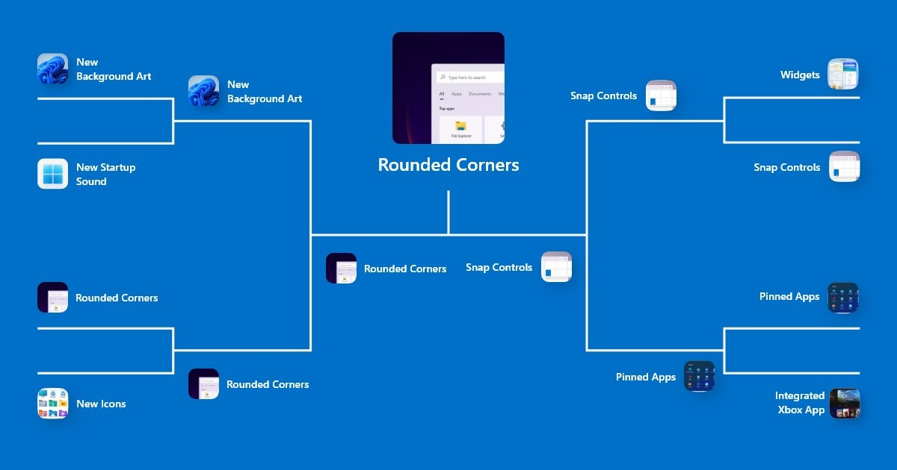
Features

Slide 7
Office History and Architecture

Slide 8



History
the 90s
Office XP
Office 2010
Office 2003
Office 2013
Office 2019
Office 2016
Microsoft 365
Office 2021

Slide 9
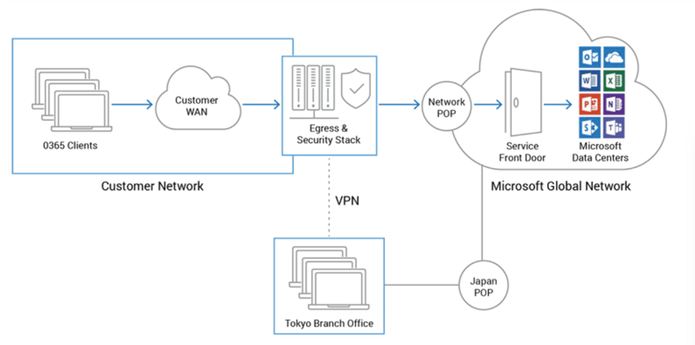
Microsoft 365
One of the most significant changes was the introduction of Office 365, which moved the suite to a subscription-based model and introduced cloud-based collaboration tools.

Slide 10


Office 365 Features
SAAS
Combination of Services
Traffic Protection
Enterprise Edge System

Slide 11




Office Evolution

Slide 12

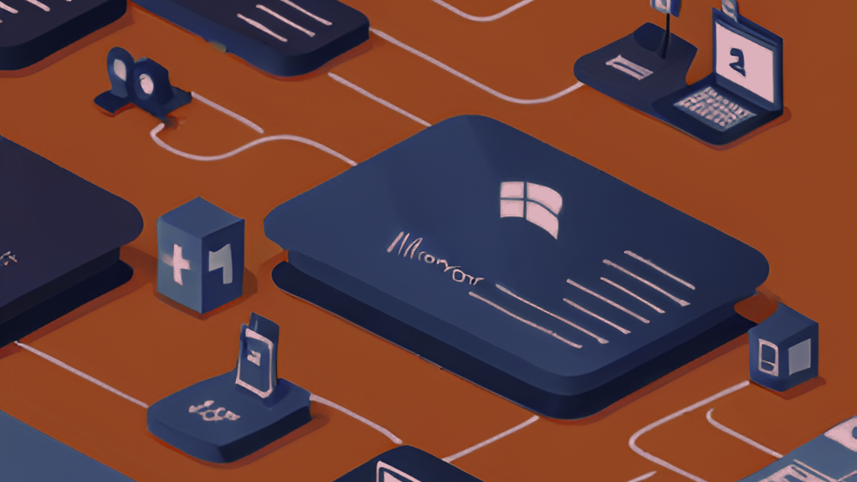
OS Evolution
Microsoft OS has evolved significantly over the years, from the early versions of MS-DOS to the latest version of Windows 10. Each new version has introduced new features and improvements, such as better security, improved performance, and a more intuitive user interface.
One of the most significant changes was the introduction of the Windows NT kernel, which replaced the older MS-DOS-based kernel. This allowed for better stability and security, as well as support for more advanced hardware.

Slide 13



Windows CoPilot
Chat Plug-ins
Bing Chat
Github CoPilot
Microsoft Fabric

Slide 14
"Microsoft is not about greed. Its about innovation and fairness"
-Bill Gates

